Slide 1
LESSON 3.3a
Introduction to Completing the Square

Slide 2
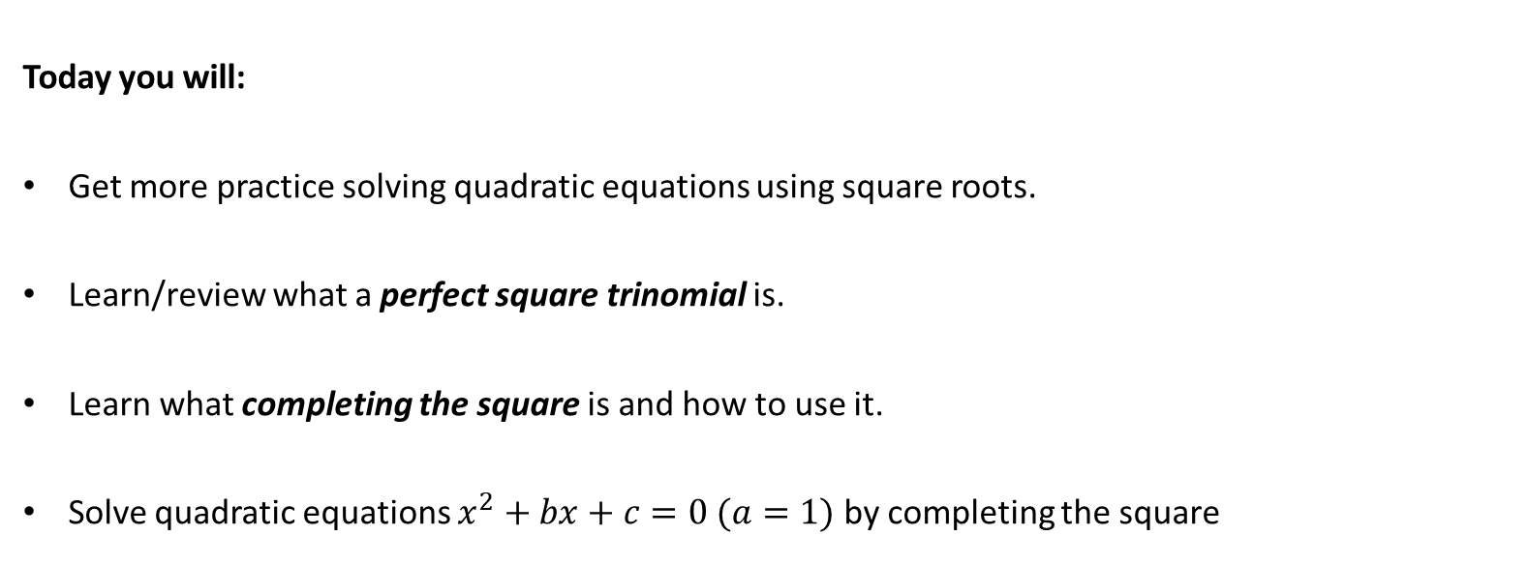
Today you will:
Get more practice solving quadratic equations using square roots.
Learn/review what a perfect square trinomial is.
Learn what completing the square is and how to use it.
Solve quadratic equations $x^{2}+bx+c=0 (a=1)$ by completing the square

Slide 3
Core Vocabulary:
Perfect square trinomial
Completing the square, p. 112

Slide 4
What is a “perfect square?”
A number that can be expressed as the product of two equal integers.
…a number that is the square of an integer.
Can you think of some examples?
4 (2 * 2)
9 (3 * 3)
121 (11 * 11)
529 (23 * 23)

Slide 5
What is a “trinomial?”
An expression with three terms connected with plus and/or minus.
Can you think of some examples?
$x^{2}+3x+2$
${5x}^{2}−2x+12$
(these are both quadratics … note that a trinomial does not need to be a quadratic)

Slide 6
What is a “perfect square trinomial?”
A trinomial that can be factored into a binomial multiplied by itself.
(what is a binomial?
Examples:
$x^{2}+4x+4=\left(x+2\right)\left(x+2\right)=(x+2)^{2}$
$x^{2}−6x+9=\left(x−3\right)\left(x−3\right)=(x−3)^{2}$
… an expression with two terms connected with plus and/or minus)

Slide 7
Solve $(x−8)^{2}=100$
$(x−8)^{2}=100$
$$\sqrt{(x−8)^{2}}=\sqrt{100}$$
$$x−8=±10$$
$$x=8±10$$

Slide 8
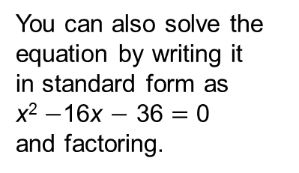
You can also solve the equation by writing it in standard form as
x² $−$16x $−$ 36 $=$ 0
and factoring.
Solve x² $−$ 16x $+$ 64 $=$100 using square roots.
SOLUTION
x² $−\text{16}\text{x}+$ 64 $=$ 100
Write the equation.
$\left(\text{x} −\text{8}\right)$² $=$ 100
Write the left side as a binomial squared.
$\text{x}−\text{8}$ $=$ $±$10
Take square root of each side.
x $=$ 8 $±\text{1}\text{0}$
Add 8 to each side.
So, the solutions are x $=$ 8 $+$ 10 $=$ 18 and x $=$ 8 $−$ 10 $= −$2.

Slide 9
What would I have to add to $x^{2}+4x$ to make it a perfect square trinomial?
In other words given $x^{2}+4x+c$, what would $c$ have to be to make it a perfect square trinomial?
Let’s think about this:
In $x^{2}+bx+c$ remember we have said that $b=p+q$ and $c=p∙q$
…here we are wanting to make a perfect square trinomial…
…what does that mean/say about $p and q$?
Well, $c$ will need to be a perfect square …
If $c=p∙p$ (and $p=q$) what can we say about $b$?
$b=p+q$ and if $p=q$ then $b=p+p=2p$
In this problem $b=4$ which means $4=2p$ so $p=2.$
S$o c=2∙2=4$
which means $c=p^{2}$ …
in other words $p=q$
Take $b$, divide it in two, then multiply it by itself…
To make $x^{2}+bx+c$ a perfect square $c={\left(\frac{b}{2}\right)}^{2}$

Slide 10
COMPLETING THE SQUARE
To complete the square for the expression $x^{2}+bx$, add ${\left(\frac{b}{2}\right)}^{2}:$
$$x^{2}+bx+{\left(\frac{b}{2}\right)}^{2}=\left(x+\frac{b}{2}\right)\left(x+\frac{b}{2}\right)={\left(x+\frac{b}{2}\right)}^{2}$$
Example: Complete the Square for $x^{2}+18x$ (make it a perfect square trinomial)
$$b=18$$
$$c={\left(\frac{b}{2}\right)}^{2}={\left(\frac{18}{2}\right)}^{2}=9^{2}=81$$
So the answer is: $x^{2}+18x+81$

Slide 11
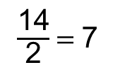
Find the value of c that makes x² $+$ 14$\text{x} +$c a perfect square trinomial. Then write
the expression as the square of a binomial.
SOLUTION
Step 1 Find half the coefficient of x.
$\frac{\text{14}}{\text{2}}$ $=$ 7
Step 2 Square the result of Step 1.
7² $=$ 49
Step 3 Replace c with the result of Step 2.
x² $+$ 14x $+$ 49
The expression x² $+$ 14x $+$ c is a perfect square trinomial
when c $=$ 49. Then x² $+$ 14x $+$ 49$=$ (x $+$ 7)(x $+$ 7) $=$ (x $+$ 7)².

Slide 12
Using COMPLETING THE SQUARE to solve a quadratic
Solve${ x}^{2}−18x+5=0:$
$$x^{2}−18x+5=0$$
$$−5 −5$$
$$x^{2}−18x =−5$$
$$b=18$$
$$c={\left(\frac{b}{2}\right)}^{2}={\left(\frac{−18}{2}\right)}^{2}={\left(−9\right)}^{2}=81$$
$$x^{2}−18x+81=−5+81$$
$$x^{2}−18x+81=76$$
$$\left(x−9\right)\left(x−9\right)=76$$
${\left(x−9\right)}^{2}=76$
$$\sqrt{{\left(x−9\right)}^{2}}=±\sqrt{76}$$
$$x−9=±\sqrt{4∙19}$$
$$x=9±2\sqrt{19}$$
First move the +5 to the other side…
…now complete the square
If you add to one side, you *MUST* add to the other
…now factor and solve…

Slide 13
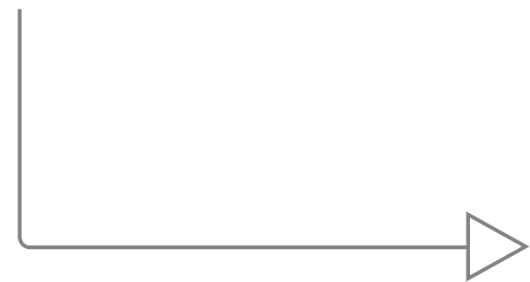
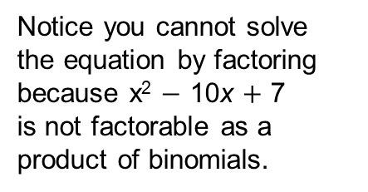
Notice you cannot solve
the equation by factoring
because x² $−$ 10x $+$ 7
is not factorable as a
product of binomials.
Solve x² $−$10x $+$ 7 $=$ 0 by completing the square.
SOLUTION
x² $−$ 10x $+$ 7 $=$ 0
Write the equation.
x² $−$ 10x $=$ $−$7
Write left side in the form x² $+$ bx.
x² $−$ 10x $+$ 25 $= −$7 $+$ 25
Add $\left(\frac{\text{b}}{\text{2}}\right)$² $=$ $\left(\frac{−\text{10}}{\text{2}}\right)$² $=$ 25 to each side.
(x $−$ 5)² $=$ 18
Write left side as a binomial squared.
x $−$ 5 $=$ $±\sqrt{\text{18}}$
Take square root of each side.
x $=$ 5 $±\sqrt{\text{18}}$
Add 5 to each side.
x $=$ 5 $±\text{3}\sqrt{\text{2}}$
Simplify radical.

Slide 14
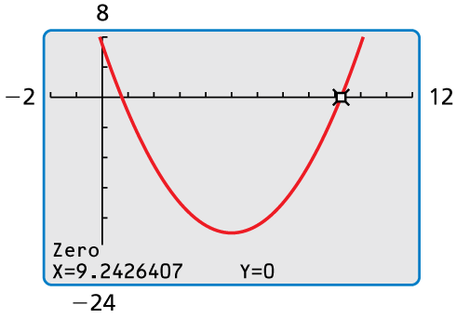
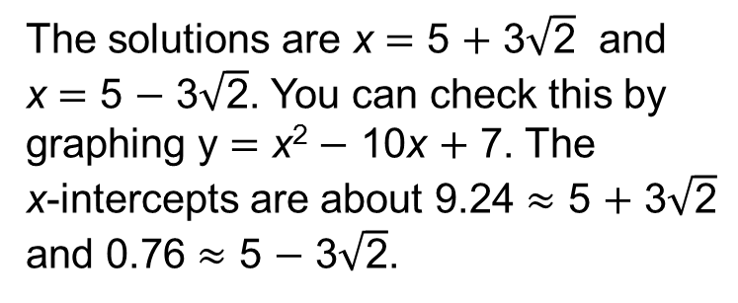
The solutions are $\text{x}$ $=$ 5 $+$ 3$\sqrt{\text{2}}$ and
$\text{x}$ $=$ 5 $−$ 3$\sqrt{\text{2}}$. You can check this by
graphing y $=$ $\text{x}$² $−$ 10$\text{x}$ $+$ 7. The
$\text{x}$-intercepts are about 9.24 $≈$ 5 $+$ 3$\sqrt{\text{2}}$
and 0.76 $≈$ 5 $−$ 3$\sqrt{\text{2}}$.
Check

Slide 15
Homework
Pg 116 #1-20, 25-30

